Slide 1
Meta-Momentum Timing Strategy
Quant Team – Brandon Ly (deduceBrandon@gmail.com), Ellie Evans, Mark Rose
(Silver Fund – 2020)

Slide 2
Table of Contents
Executive Summary
Meta-Momentum Strategies
Design Parameters
Robustness

Slide 3
Executive Summary

Slide 4
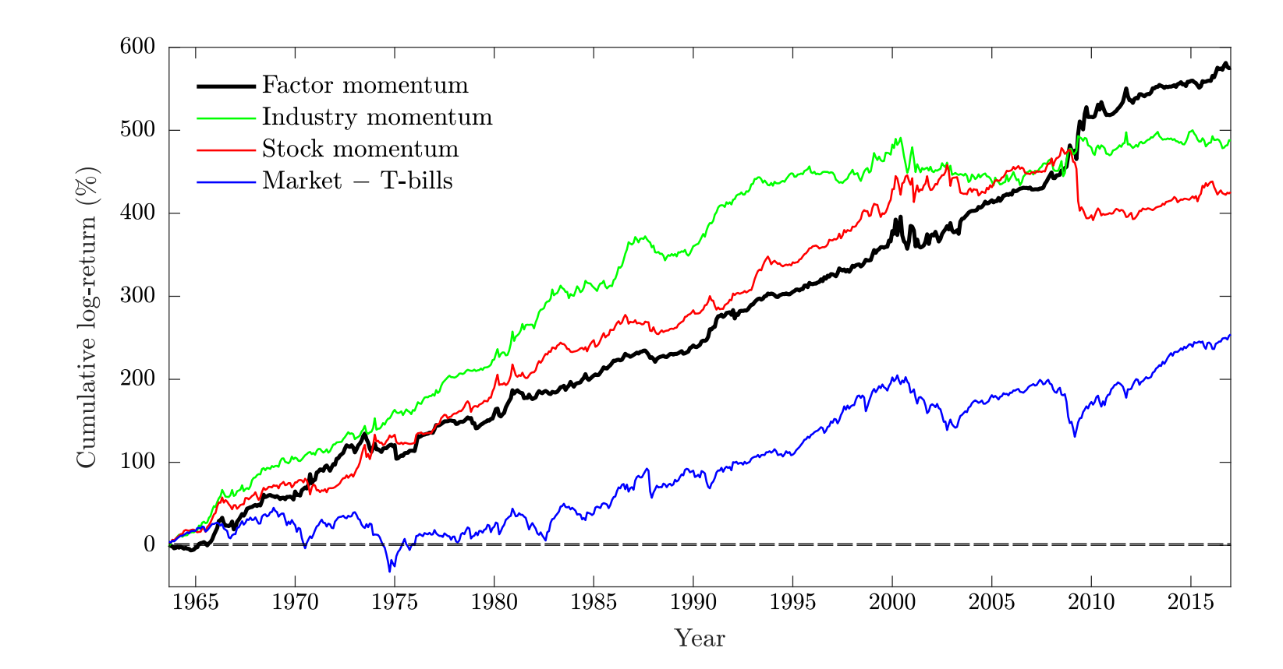
Motivation for timing

Slide 5
Outline
The Meta-Momentum Factor investing strategy is a robust factor timing method
Use historical data to determine the winners and losers
Use cross-validation methods to ensure the robustness of the parameters that we find
Propose a strategy—that is, a set of rules that we will implement systematically to be used in timing our investments

Slide 6
Thesis
Behavioral
Trading/liquidity frictions
Over/under reactions to information
Markets aren’t efficient
Notes:
This works for stock momentum, our thesis is that this works for factor momentum as well.

Slide 7
Meta-Momentum Strategies
Notes:
Brandon (4 min total on this)

Slide 8
2 Types of Meta-Momentum
Absolute
Winning factor: Factor return is positive over the formation period
Losing factor: Factor return is negative over the formation period
Relative
Winning factor: Which factor return is highest
Losing factor: Which factor return is lowest
Notes:
Notes - the number of absolute factors can change with each calculation, but relative won’t

Slide 9
Constructing Momentum Strategy
Take factor returns as far back as necessary
Select winning and losing factors according either to relative or absolute momentum
Propose a long-short portfolio with stocks with the highest factor loadings on winning and losing factors
Generate expected returns using predicted factor returns via exponentially weighted moving average
Optimize and rebalance portfolio

Slide 10
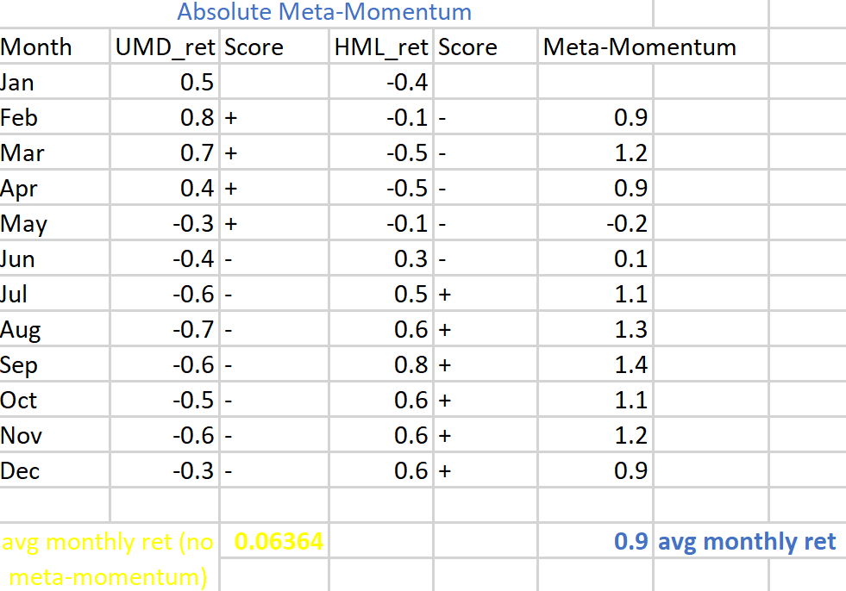
Notes:
Brandon (3 min) - I plan on spending the most time here so people really get an MBA intuition behind what’s happening.

Slide 11
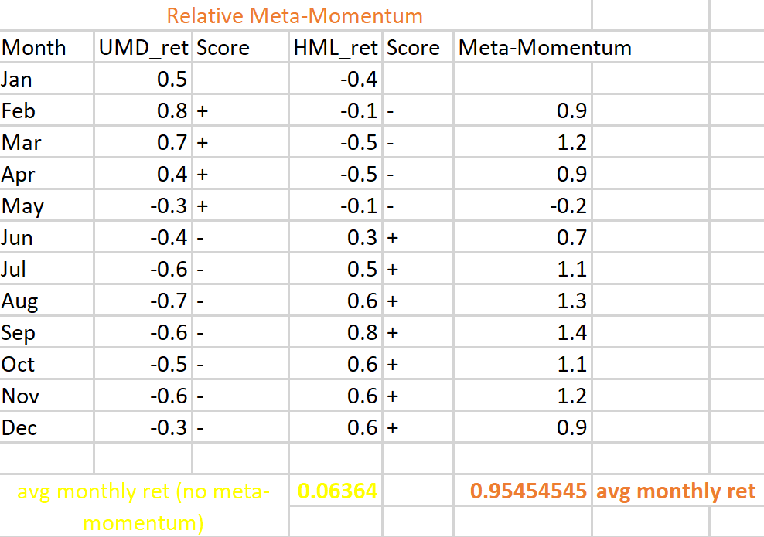
Notes:
Brandon (30 sec) - this is almost a repeat of the last slide, so don’t need to spend a lot of time

Slide 12
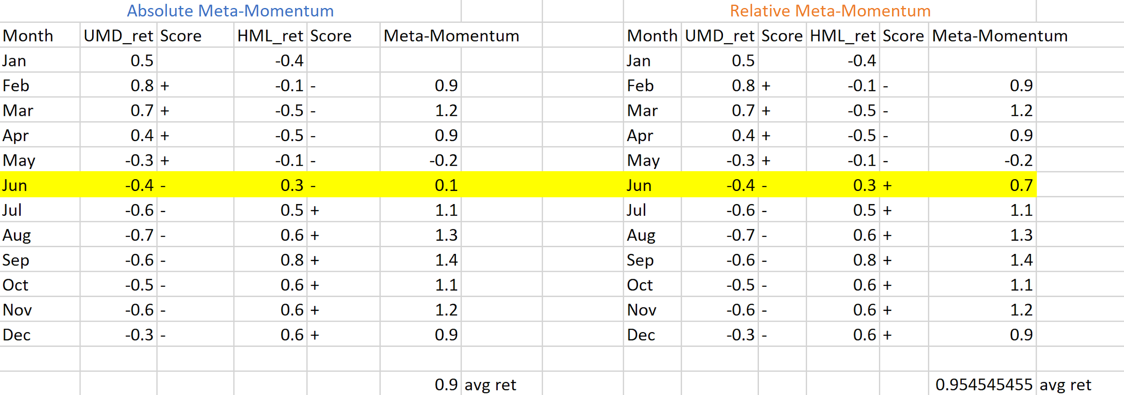
What’s the Difference?
Notes:
Brandon (30 sec) - quick discussion on how the two differ. Note, in the example relative beats absolute but that’s just for this example. Not true in general.

Slide 13
Design Parameters

Slide 14
Parameters
Formation Period
How much backward-looking data we use to calculate momentum
Holding Period
How long into the future we hold portfolio
Rebalance every month
Formation-Holding Period Gap
How many days/months to exclude between holding and formation periods
Cut-offs
What determines a winning factor?
Absolute: Factor returns positive
Relative: Best performing in the cross-section

Slide 15
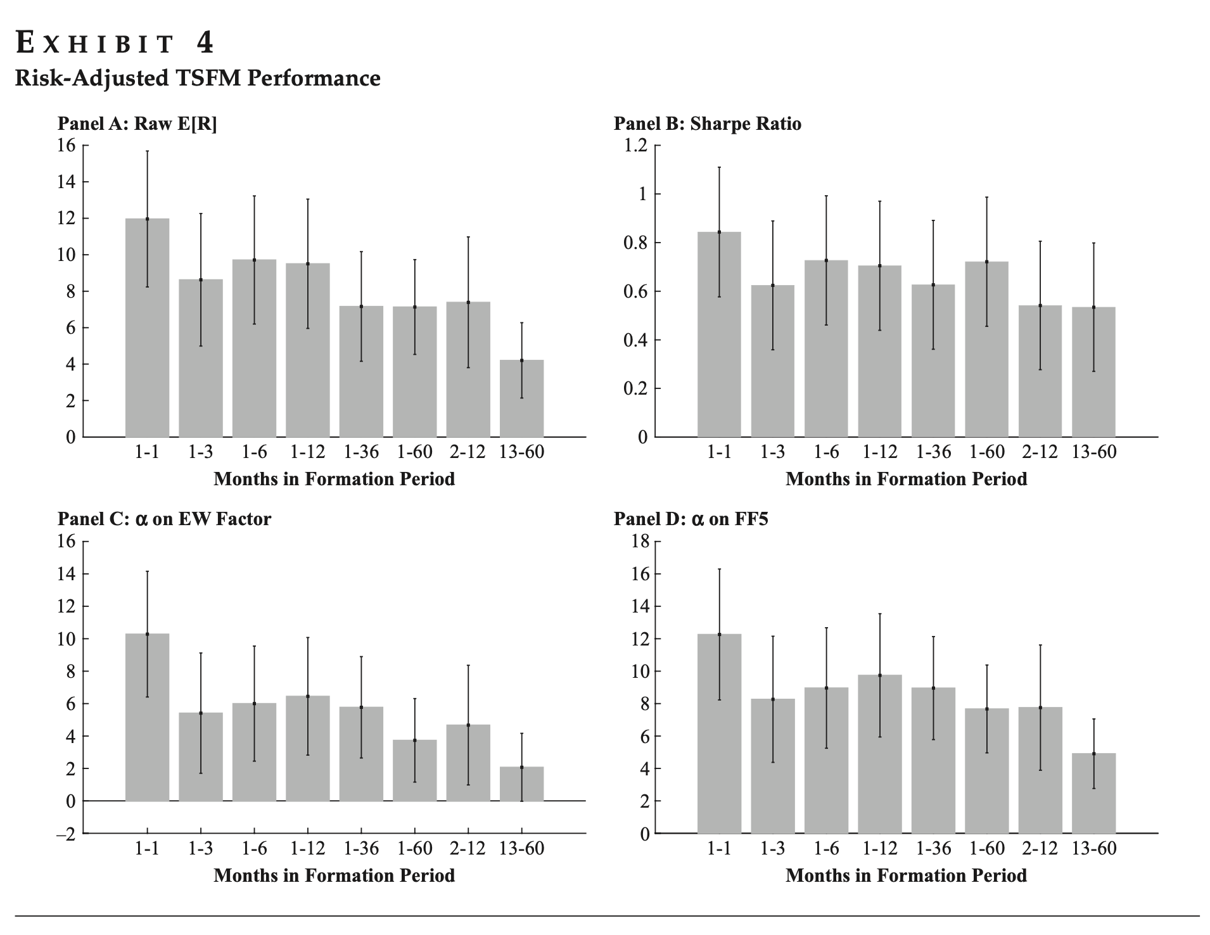
Formation
period
matters.

Slide 16
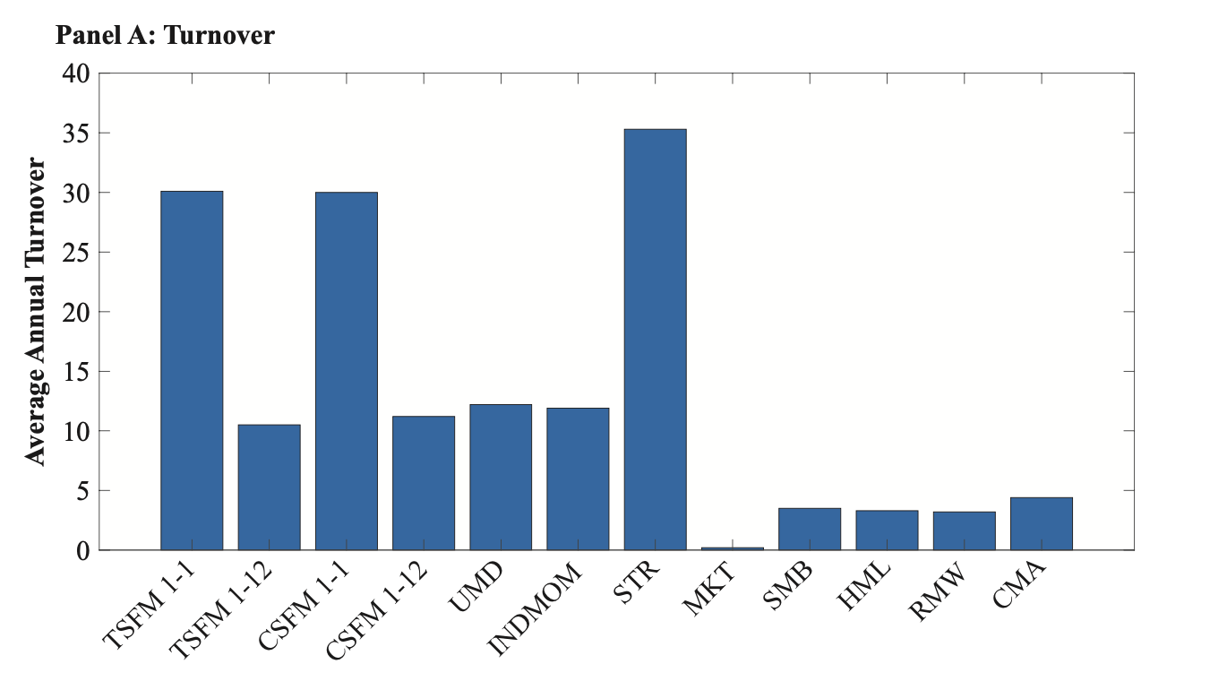
Transaction Costs
Fama-French 5 factors
There’s a fairly high turnover rate compared to other strategies…

Slide 17
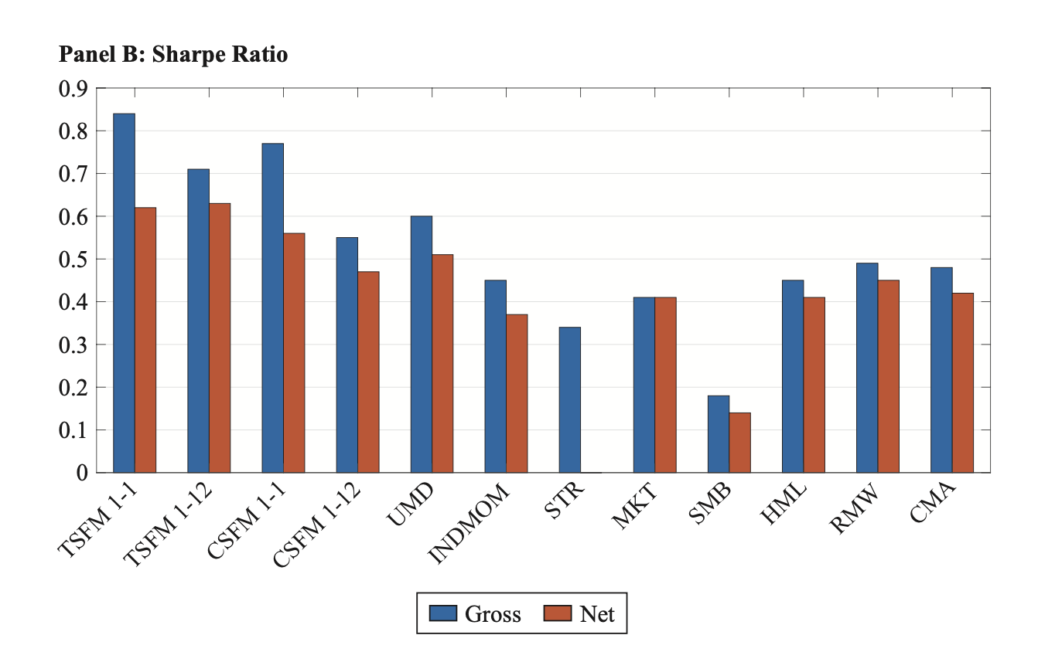
…but there’s evidence that factor momentum strategies outperform other factors regardless.
Notes:
Assuming t-costs of 10 bps per unit of turnover

Slide 18
Robustness Checks
Notes:
Brandon (1 minute total on this)

Slide 19
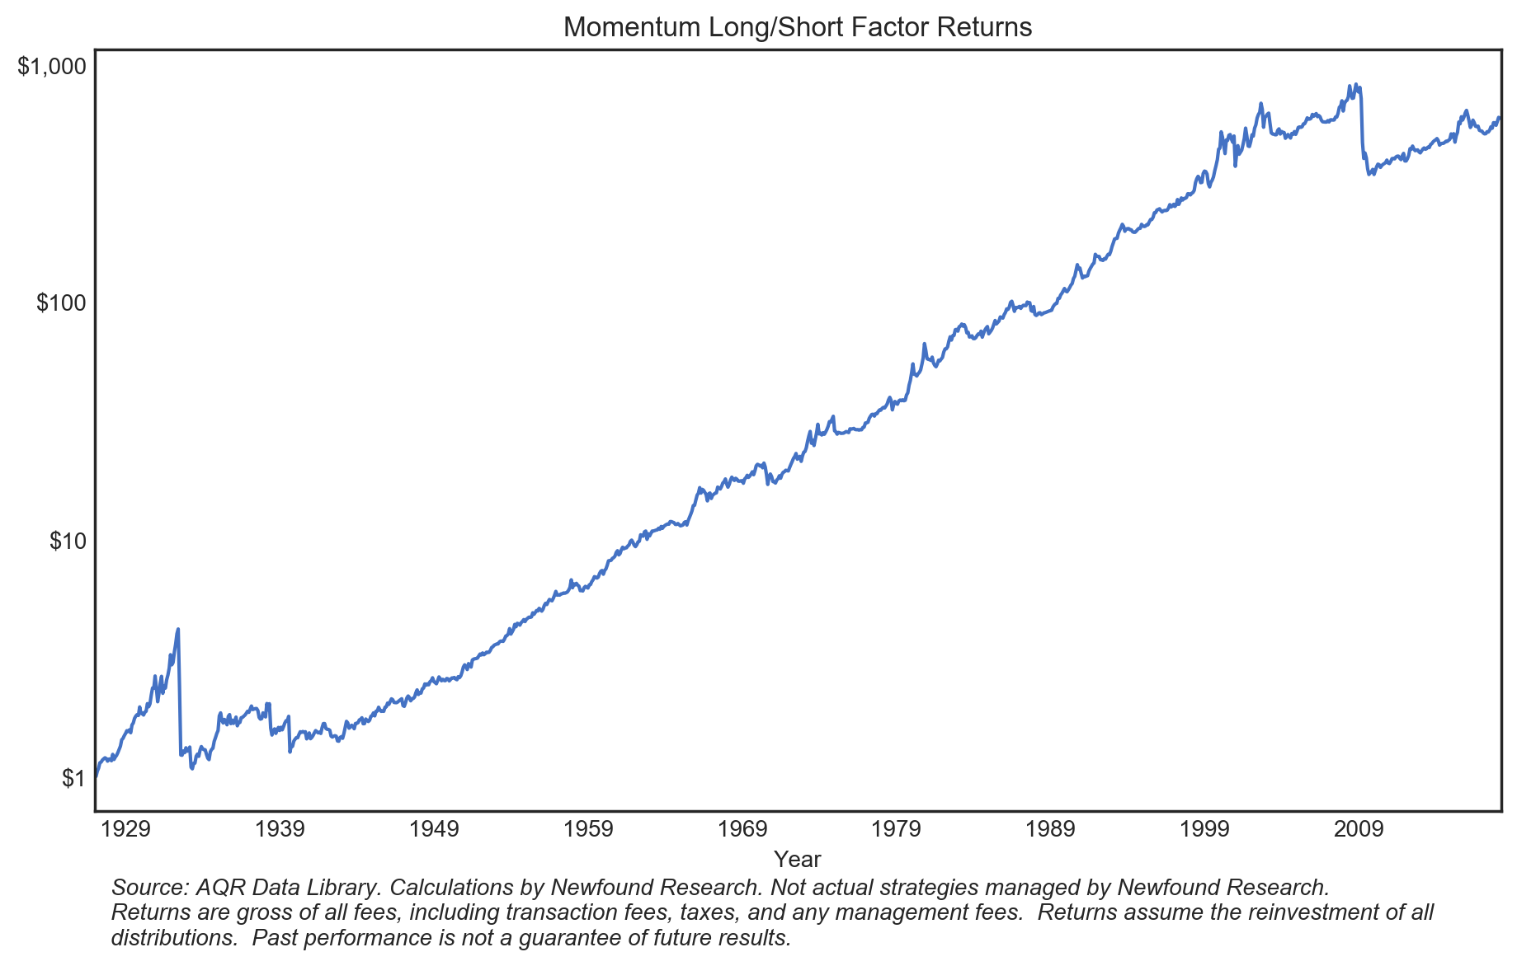
Momentum Crash ‘09
Notes:
Brandon (10 sec) - This is a quick example of what can go wrong without robustness, although technically momentum is still considered “robust”.

Slide 20
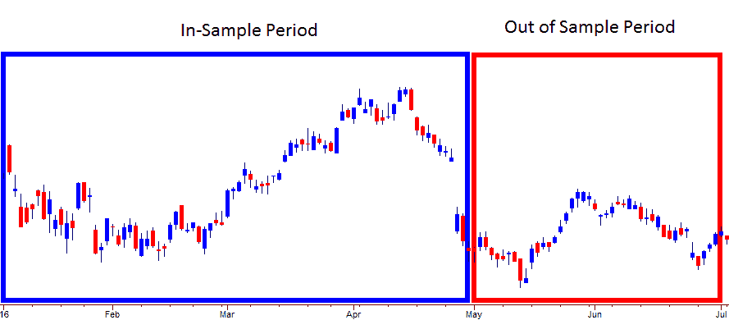
Robustness - OOS Test
Cross validation or out-of-sample testing is a model validation technique for assessing how the results of a statistical analysis will generalize to an independent data set.
Notes:
Brandon (10 sec) - Quick explanation of reserving 2015-2020 data to “test” our strategy created from 1960-2015.
1963 - 2020
Cross validation or out-of-sample testing is a model validation technique for assessing how the results of a statistical analysis will generalize to an independent data set.

Slide 21
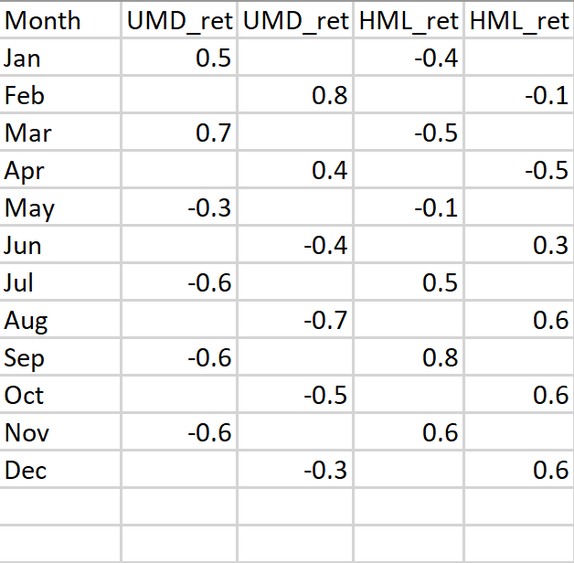
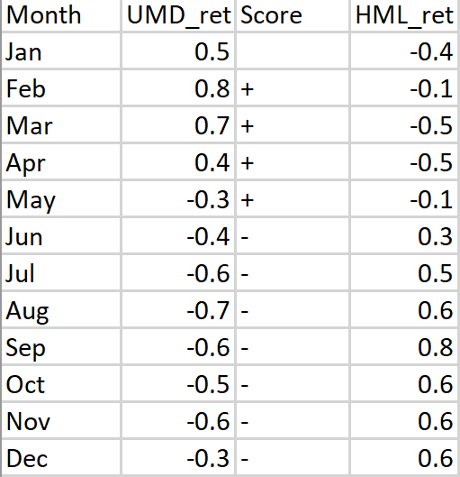
Even/Odd Test
Notes:
Brandon (10 sec) - This is just dividing the data into even and odd months visually.

Slide 22
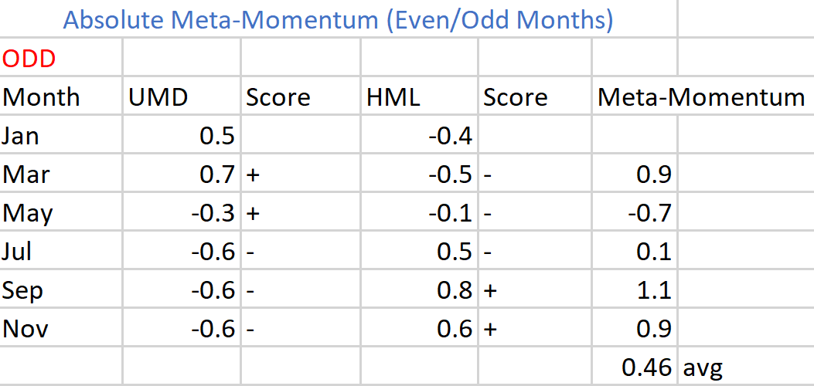
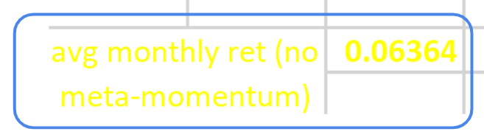
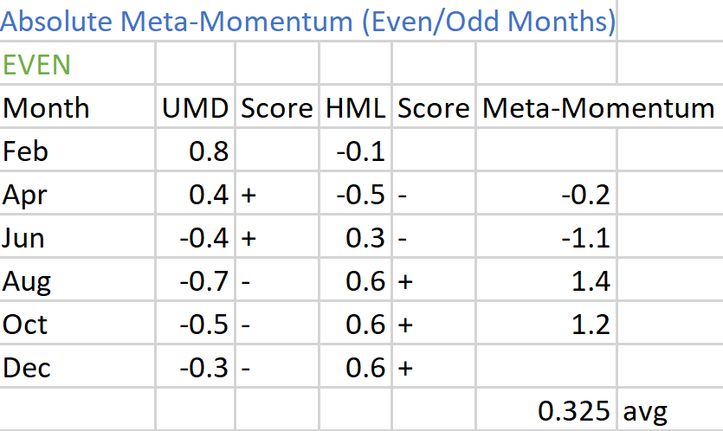
Notes:
Brandon (30 sec) - This is more for Bates than anyone. I hope the testing period I did (using Apr returns to test March’s strategy) is correct.

